Slide 1

Understanding a deep Neural Network
Srijita Das

Slide 2
Sections
Motivation
Background
Architecture
Experiments
Conclusion

Slide 3
Motivation

Slide 4

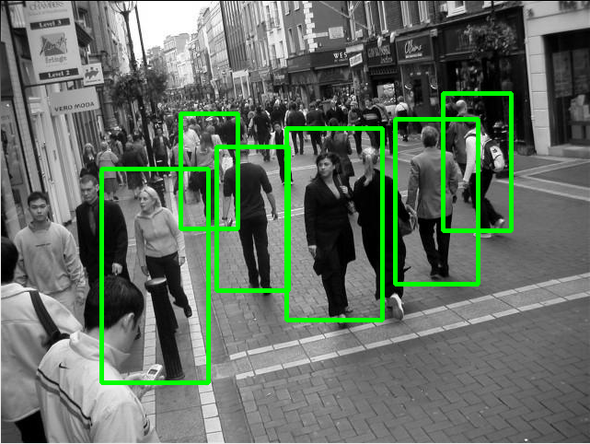

Why should we care??
Greater accuracy!!
Less training time!!

Slide 5
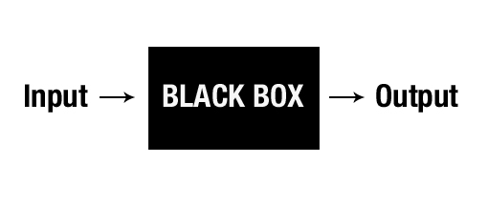
Deep Neural nets: A black box?

Slide 6
Background

Slide 7
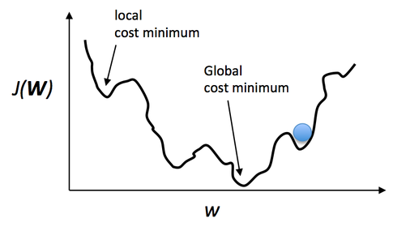
Difficulties: Non-Convex function

Slide 8

Difficulties: Vanishing Gradient

Slide 9
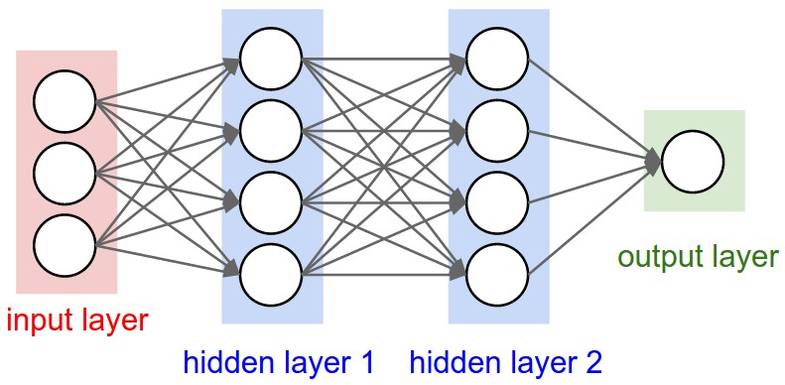
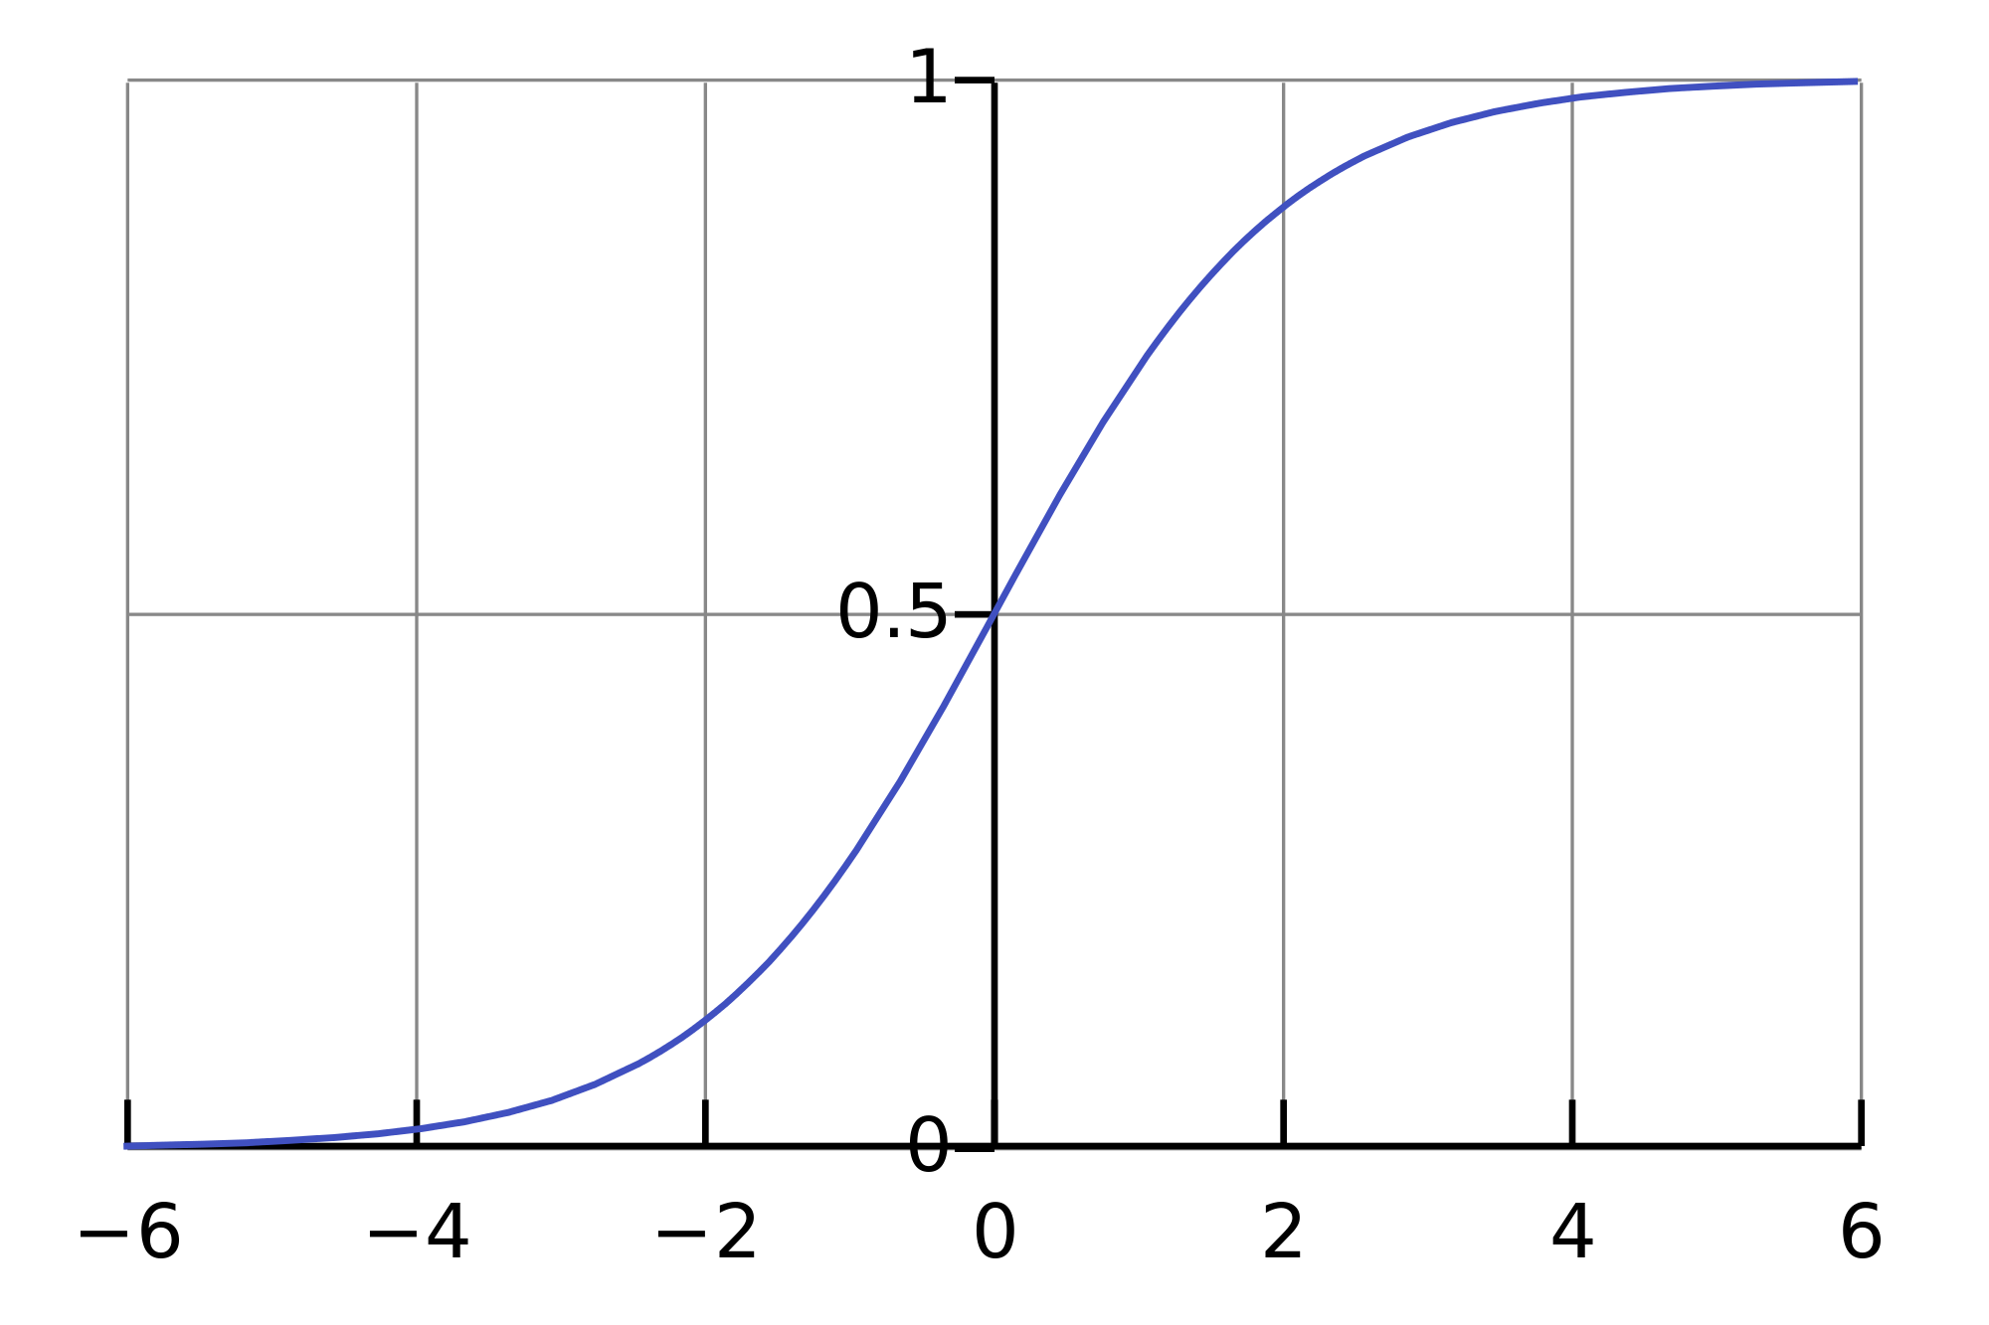
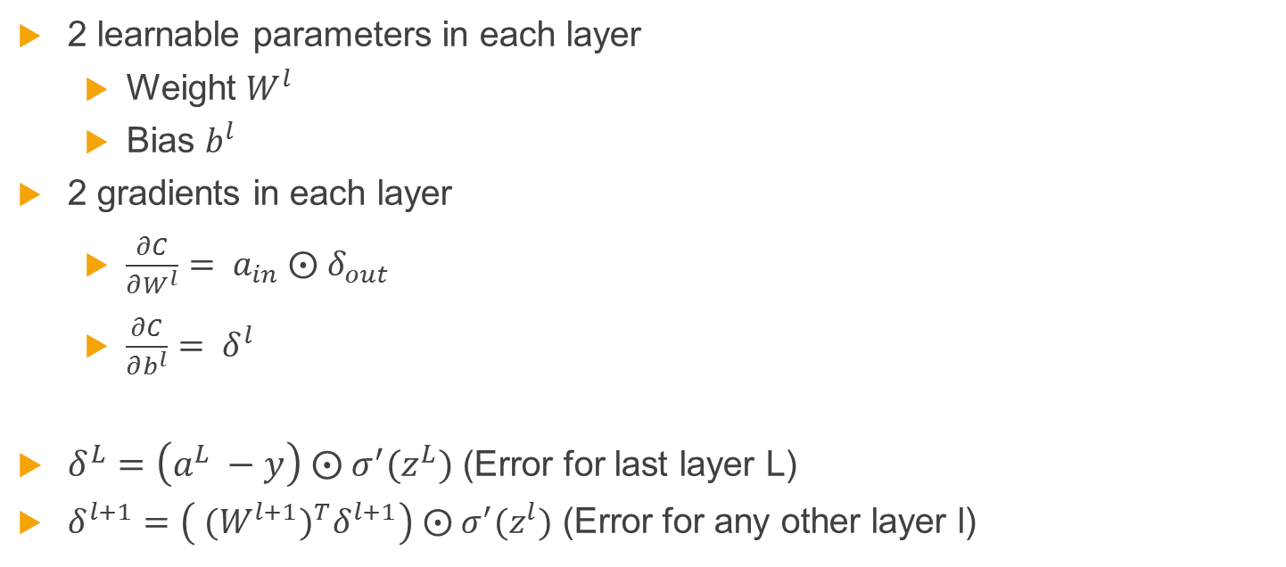
Gradients in deep neural network
2 learnable parameters in each layer
Weight $W^{l}$
Bias $b^{l}$
2 gradients in each layer
$\frac{∂C}{∂W^{l}}= a_{in} ⨀{ δ}_{out}$
$\frac{∂C}{∂b^{l}}= δ^{l}$
$δ^{L}=\left(a^{L} −y\right) ⨀{ σ}^{′}(z^{L})$ (Error for last layer L)
$δ^{l+1}=\left( {(W^{l+1})^{T}δ}^{l+1}\right) ⨀{ σ}^{′}(z^{l})$ (Error for any other layer l)

Slide 10
Research problem
Explore the different gradients and their behavior
Study the effect of different kinds of initializations on deep neural network learning
Analyze the activation functions
Study the effect of momentum with various initializations

Slide 11
Network Architecture

Slide 12
Network Setting
Used publicly available deep NN codebase of Michael Nielson
Experiments on the MNIST dataset.(784 features, 10 labels)
Quadratic cost
Sigmoid activation at each layer
4 hidden layers with 100 neurons each
Learning rate of 0.3
Mini batch update of 10 data points
All results are averaged over 10 runs

Slide 13
Experiments

Slide 14
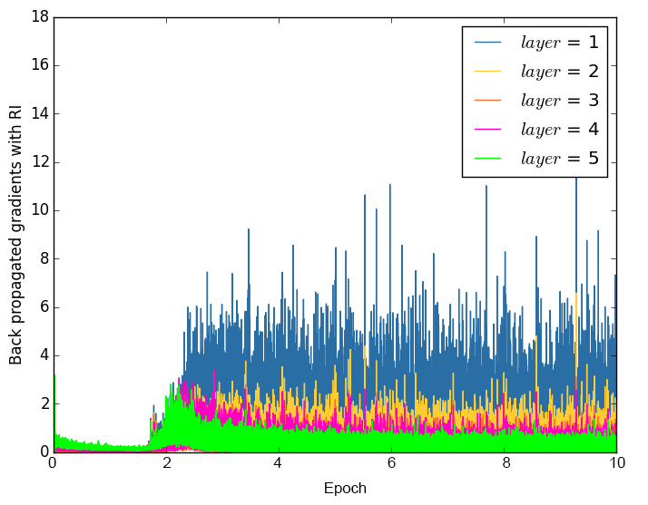
Gradients(W) with random initialization
Vanishing gradient
Learning peak at epoch 3
Top layer drives learning

Slide 15
Test Accuracy with random initialization
Epoch | Accuracy
1 | 12.343
2 | 40.036
3 | 89.456
4 | 93.466
5 | 94.273
6 | 95.06
7 | 95.606
8 | 95.766
9 | 95.556
10 | 95.91

Slide 16
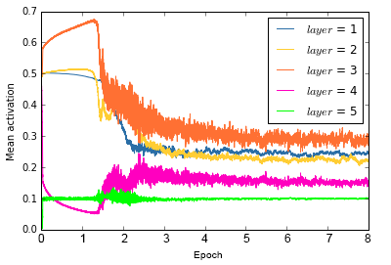
Activation function analysis for RI
L5 low activation
L5 close to saturation
Activation varies while learning.

Slide 17
Sparse Initialization
Sparsely initializes the weights at each layer
Randomly, 5 (chosen) incoming weight components of each neuron non-zero
These weights are sampled from Standard normal distribution
Remaining weights are initialized by 0
All biases are set to 0

Slide 18
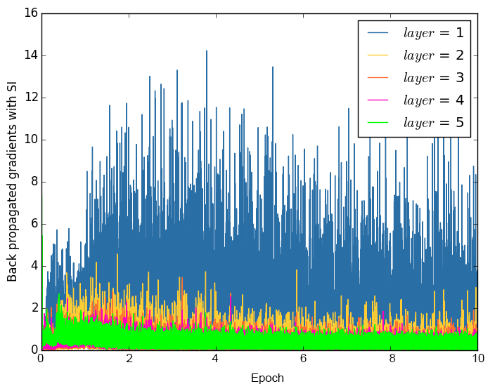
Gradient(W) with Sparse Initialization
No vanishing gradient problem
Learning peak at epoch 1
Top layer drives learning

Slide 19
Test Accuracy with Sparse initialization
Epoch | Accuracy
1 | 78.843
2 | 84.289
3 | 85.226
4 | 86.423
5 | 86.503
6 | 87.586
7 | 87.479
8 | 87.593
9 | 87.473
10 | 87.293

Slide 20
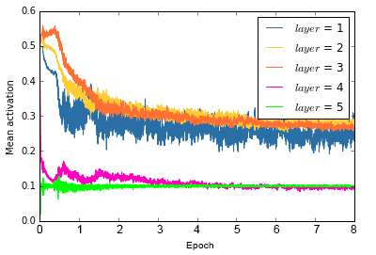
Activation function analysis for SI
L5 low activation
L4 and L5 behaves similarly.
Activation varies while learning.

Slide 21
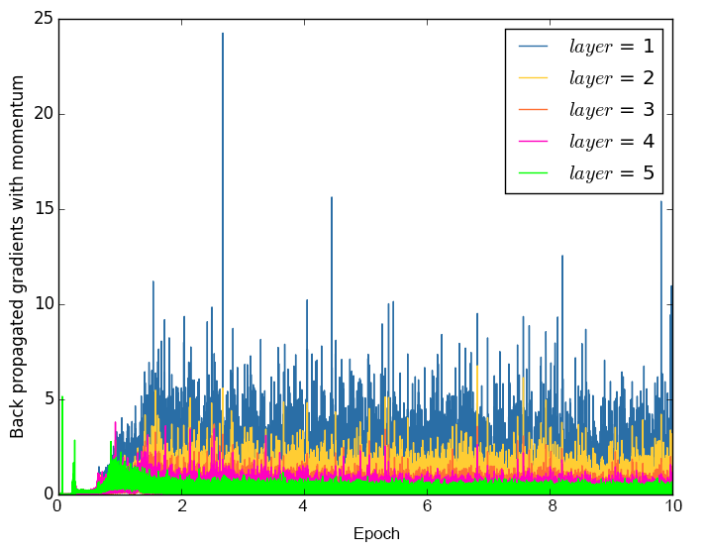
Gradient(W) of RI with momentum
Learning accelerated
Better than RI
Learning peak at epoch 1

Slide 22
Observations
For Random Initialization, a momentum coefficient of 0.5 paced up learning
For Sparse Initialization, a momentum coefficient of 0.1 for W and 0.5 for b was found to be ideal
High momentum coefficients performed poorly on Sparse Initialization

Slide 23
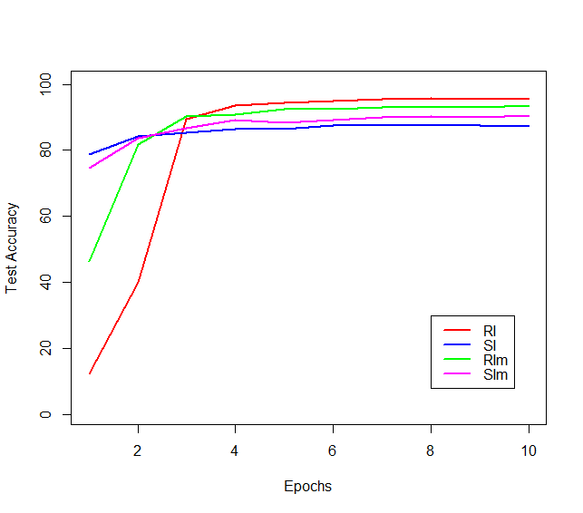
Effect of momentum and comparison

Slide 24
Conclusion
For deep neural networks, most of the learning is done by the topmost layer
Bottom layer fine tunes the solution and take it closer to a local minima
Random Initialization with momentum preferred when training time and accuracy needs to be balanced
Sparse Initialization preferred when initial learning needs to be paced up and high accuracy is not that important

Slide 25
Thank you!!

